Slide 1
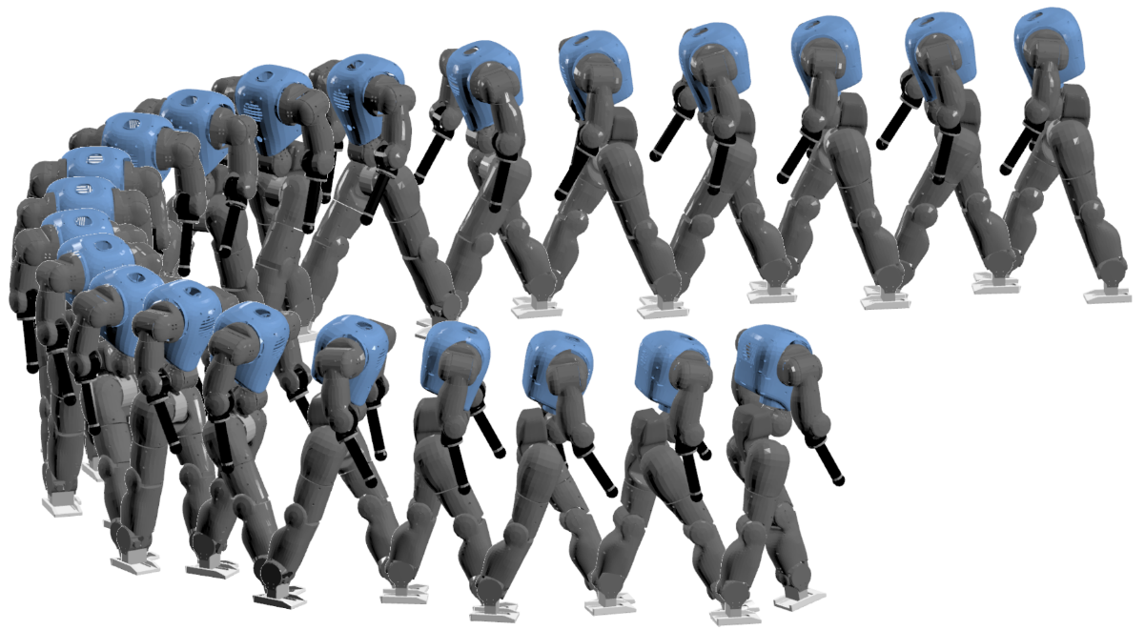
Rich and Robust Bio-Inspired Locomotion
Control for Humanoid Robots
Ph.D. thesis – Public defense
Nicolas Van der Noot
Prof Kamiar Aminian | president
Prof Renaud Ronsse | thesis director
Prof Auke Jan Ijspeert | thesis director
Prof Paul Fisette | examiner
Prof Hartmut Geyer | examiner
Prof Silvestro Micera | examiner

Slide 2
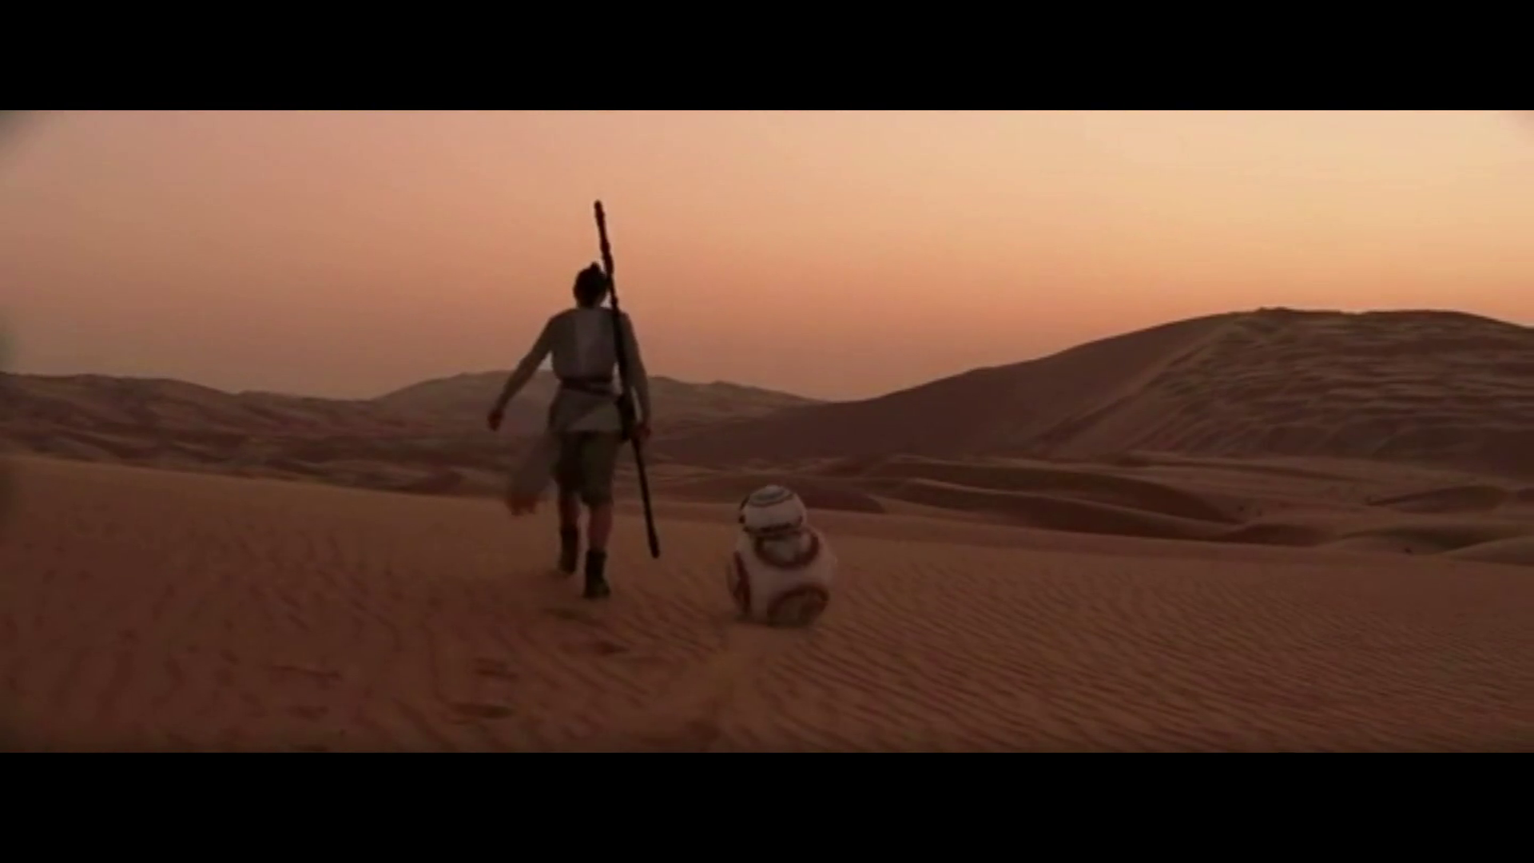
Robots capable to adapt to our environment
© Star Wars : Episode VII – The Force Awakens

Slide 3
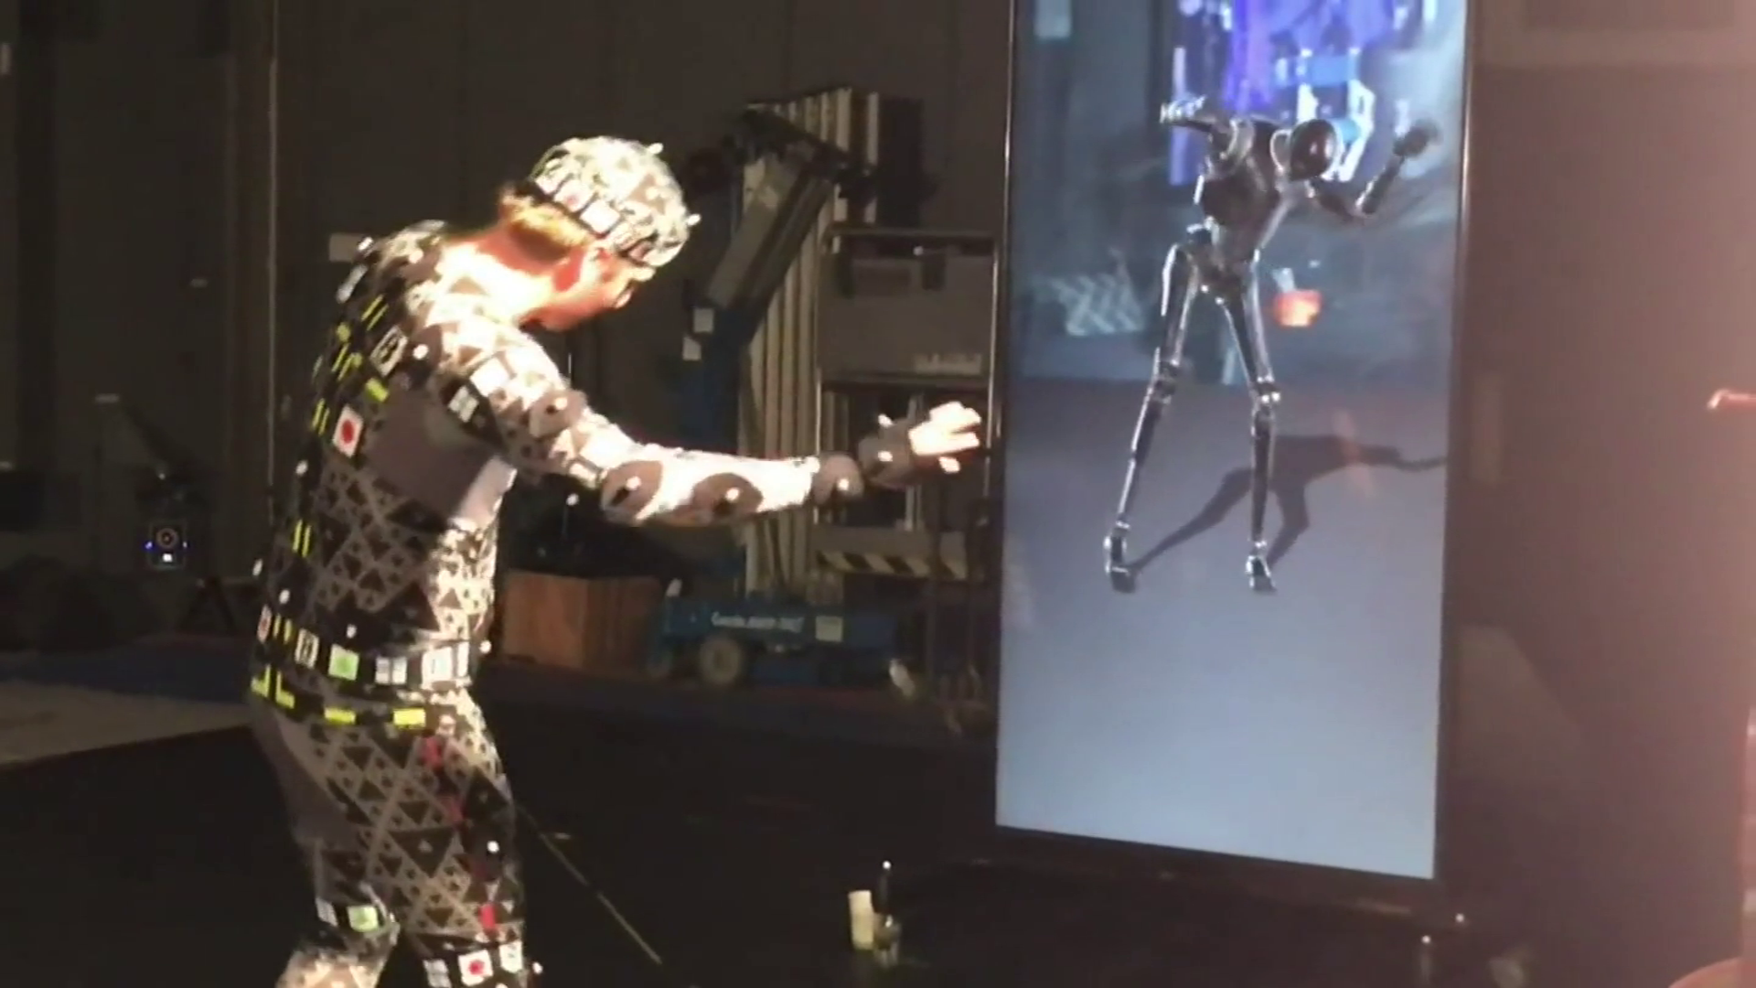
Humanoid robots in movies
© Rogue One – A Star Wars Story

Slide 4
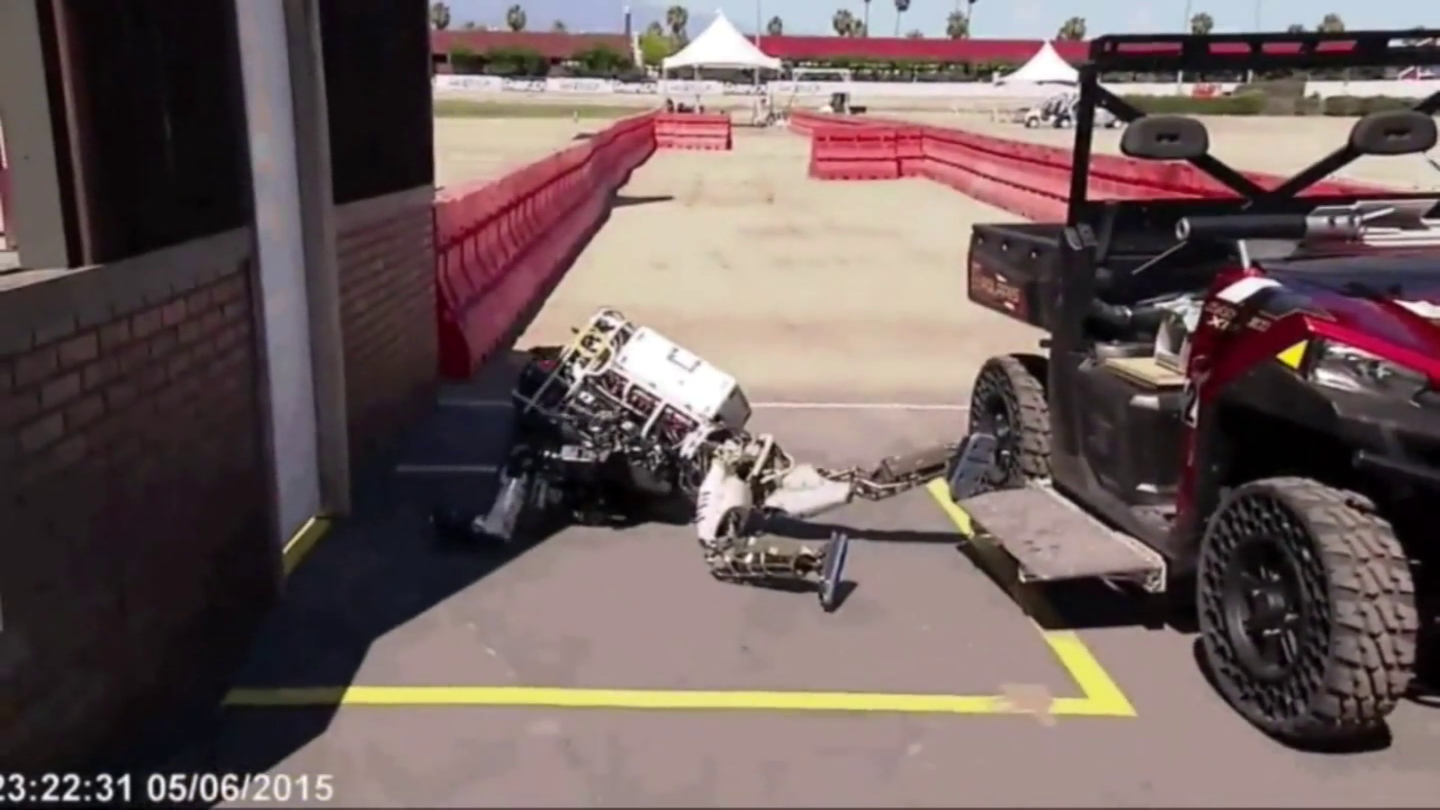
DARPA Robotics Challenge
© IEEE Spectrum – DRC compilation

Slide 5
Overview
Introduction & Methods
Reflex-based controller
Forward gait modulation in 2D scenarios
Steering control in 3D scenarios
Conclusion

Slide 6
Outline
Introduction & Methods
Reflex-based controller
Forward gait modulation in 2D scenarios
Steering control in 3D scenarios
Conclusion

Slide 7
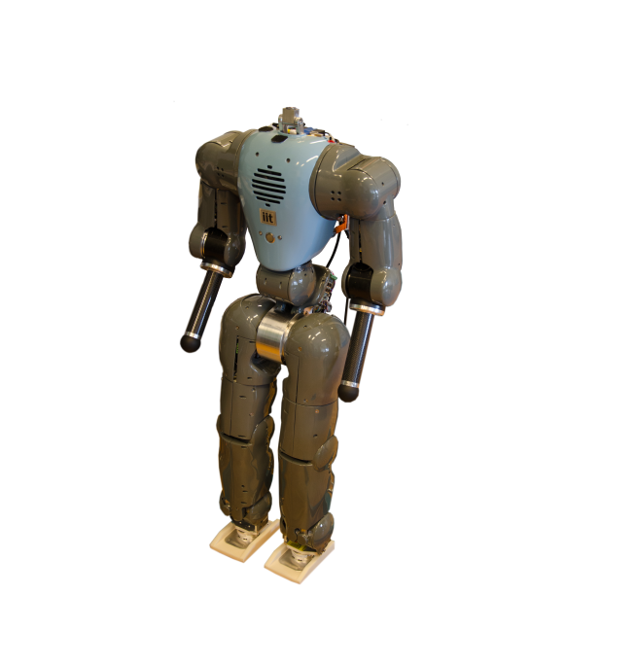
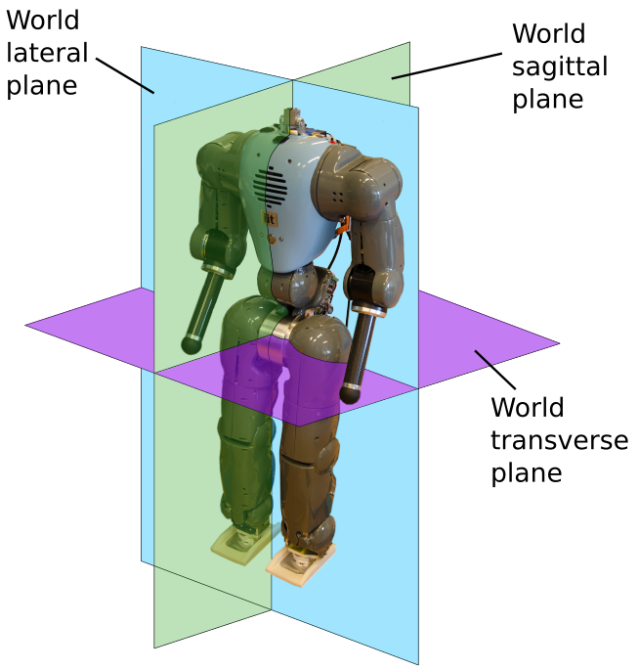
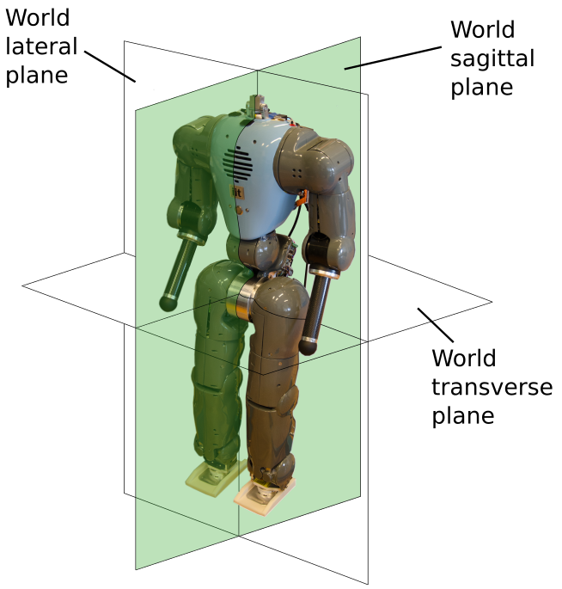
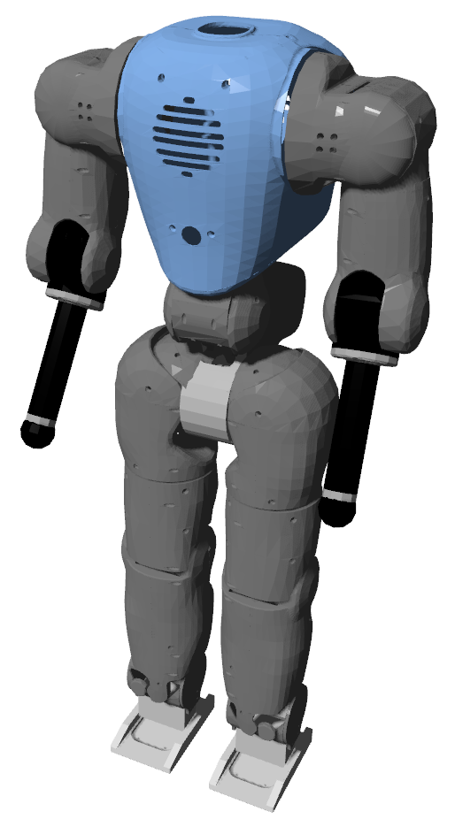
Biped embodiment: the COMAN robot
2D gait
waist motion only in the world sagittal plane
3D gait
no motion constraint
real COMAN
simulated COMAN

Slide 8
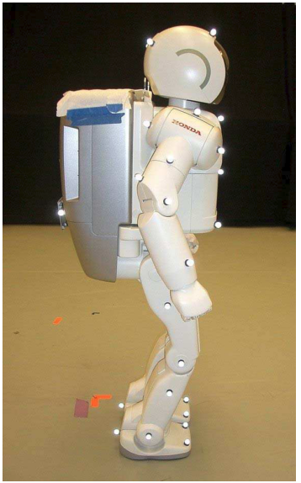
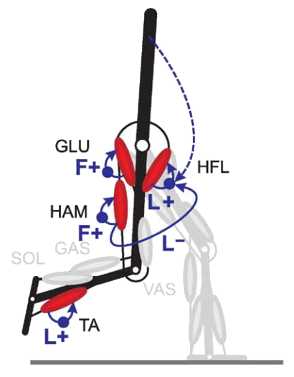
Human walking skills for robots
Traditional approaches
versatile and well known
energy inefficiency
non human-like features
Bio-inspired limit cycle walkers
energy efficiency
human-like features
many parameters to optimize
mainly in simulation
© Chestnutt, 2005
© Geyer, 2010
“A muscle-reflex model that encodes principles of legged mechanics produces human walking dynamics and muscle activities”, H. Geyer and H. Herr, 2010
Port bio-inspired controllers with steering capabilities to humanoid robots

Slide 9
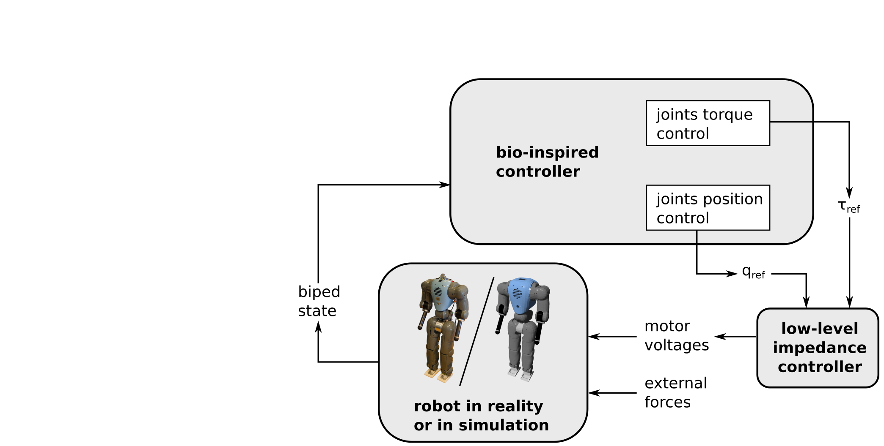
General control framework

Slide 10
Outline
Introduction & Methods
Reflex-based controller
Neuromuscular model
Experimental validation
Adaptation to different robots
Forward gait modulation in 2D scenarios
Steering control in 3D scenarios
Conclusion

Slide 11
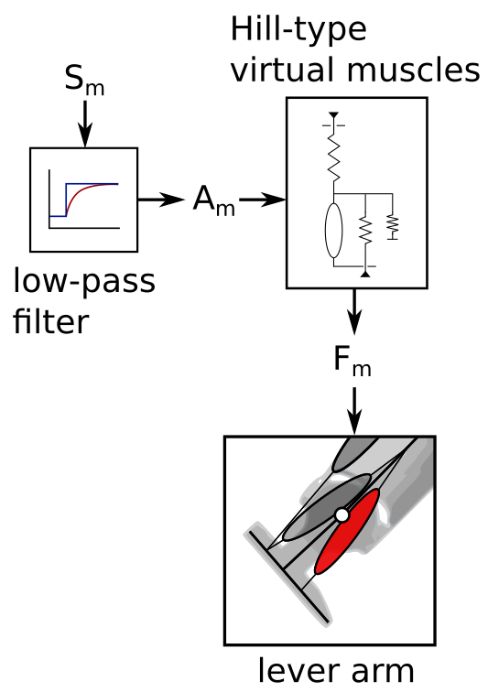
Muscle-based control

Slide 12
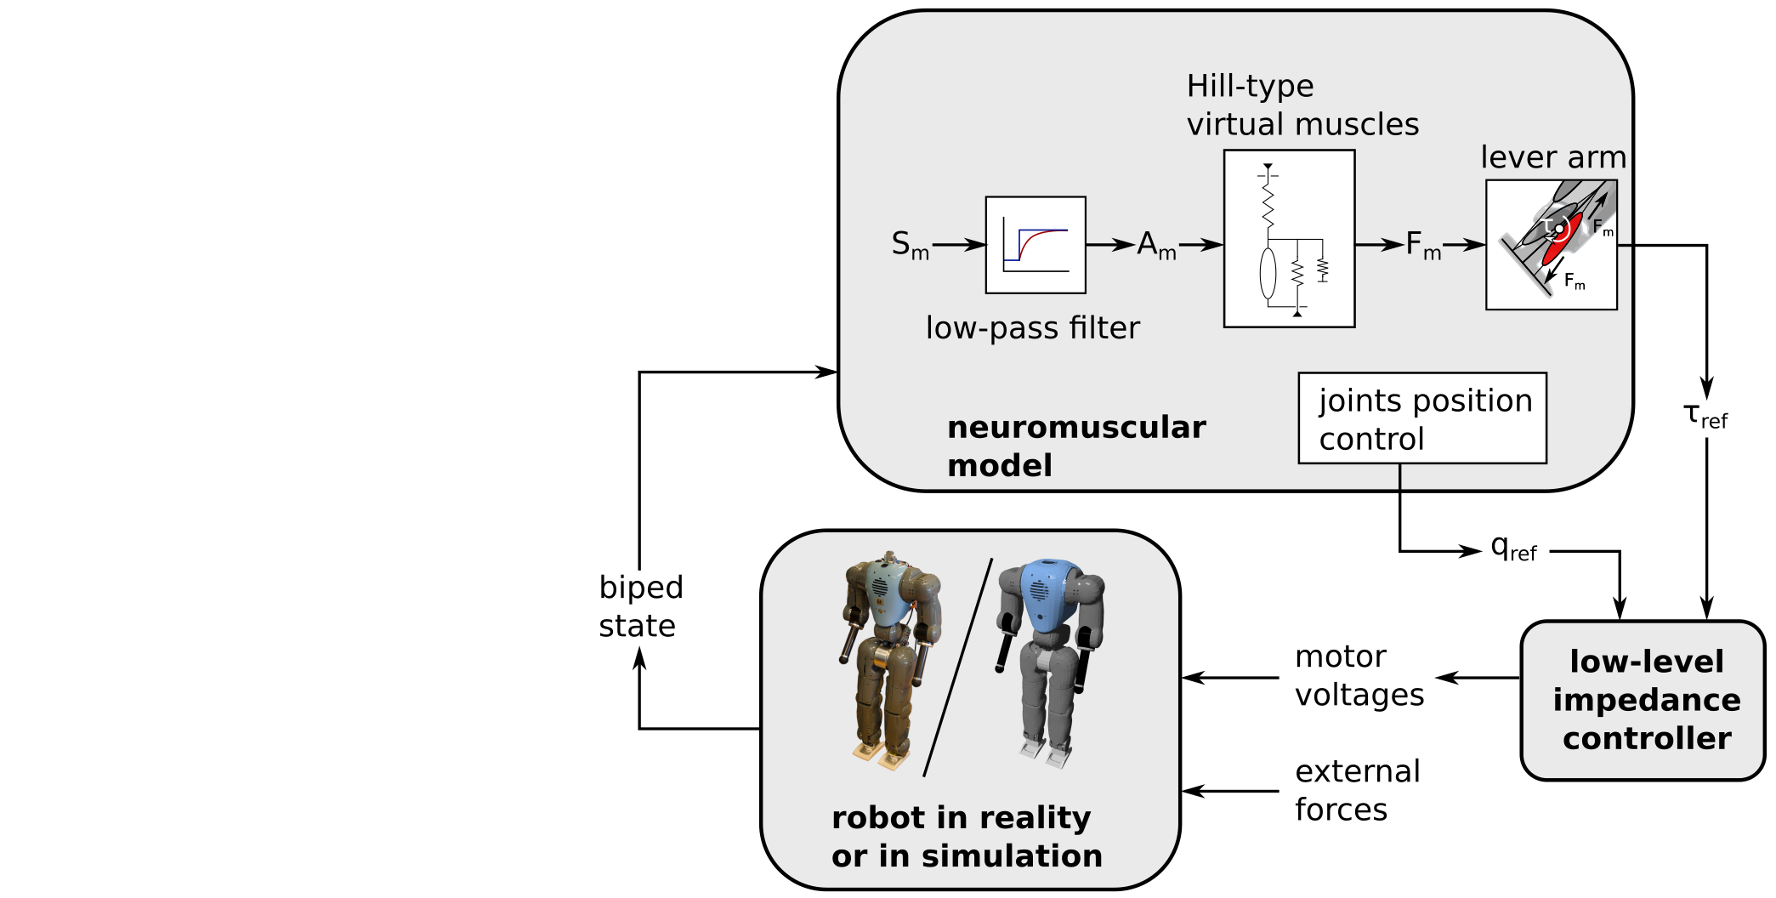
General control framework

Slide 13
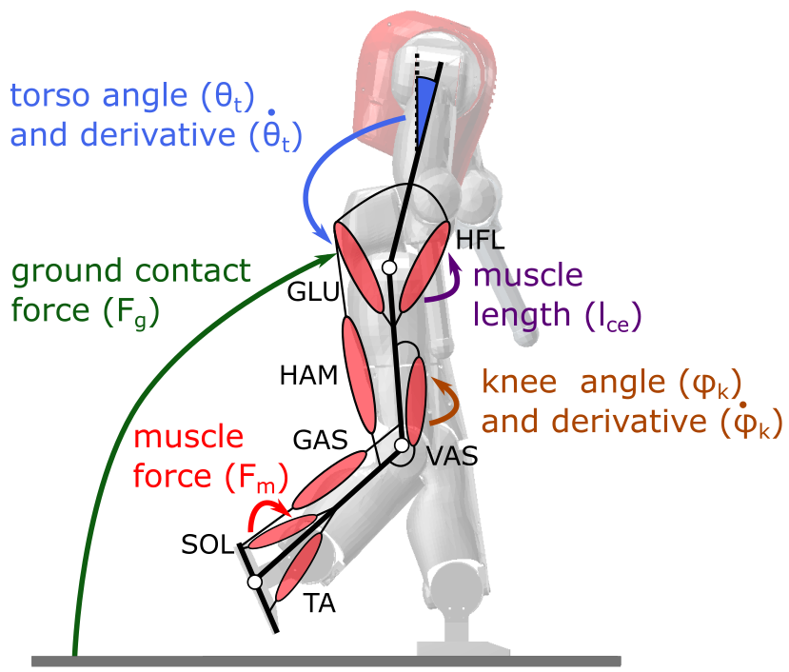
Reflex-based control
The biped is equipped with virtual Hill-type muscles in each leg.
Stimulation signals are computed based on reflex rules.
These rules are adapted from [Geyer and Herr, 2010].

Slide 14
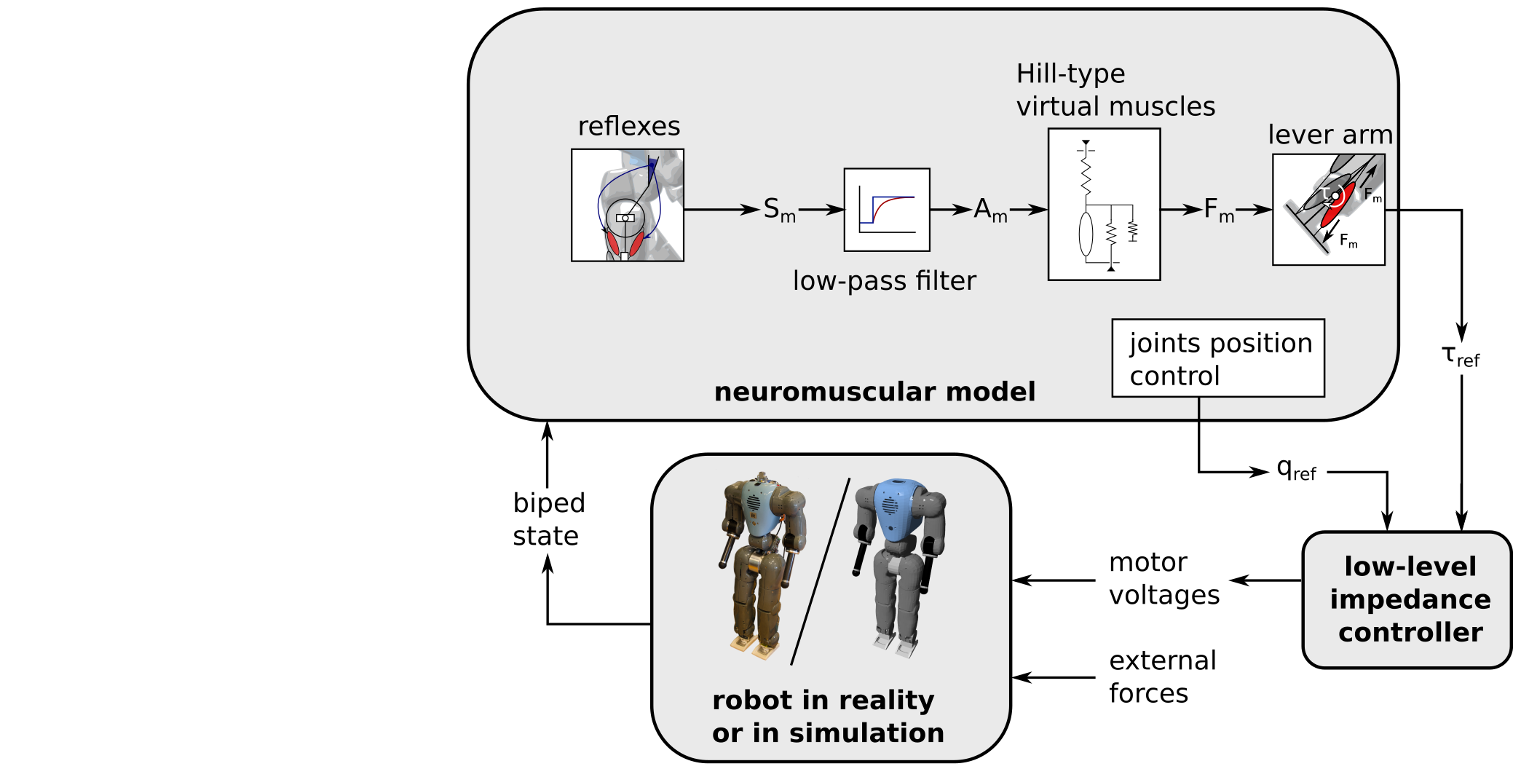
General control framework

Slide 15
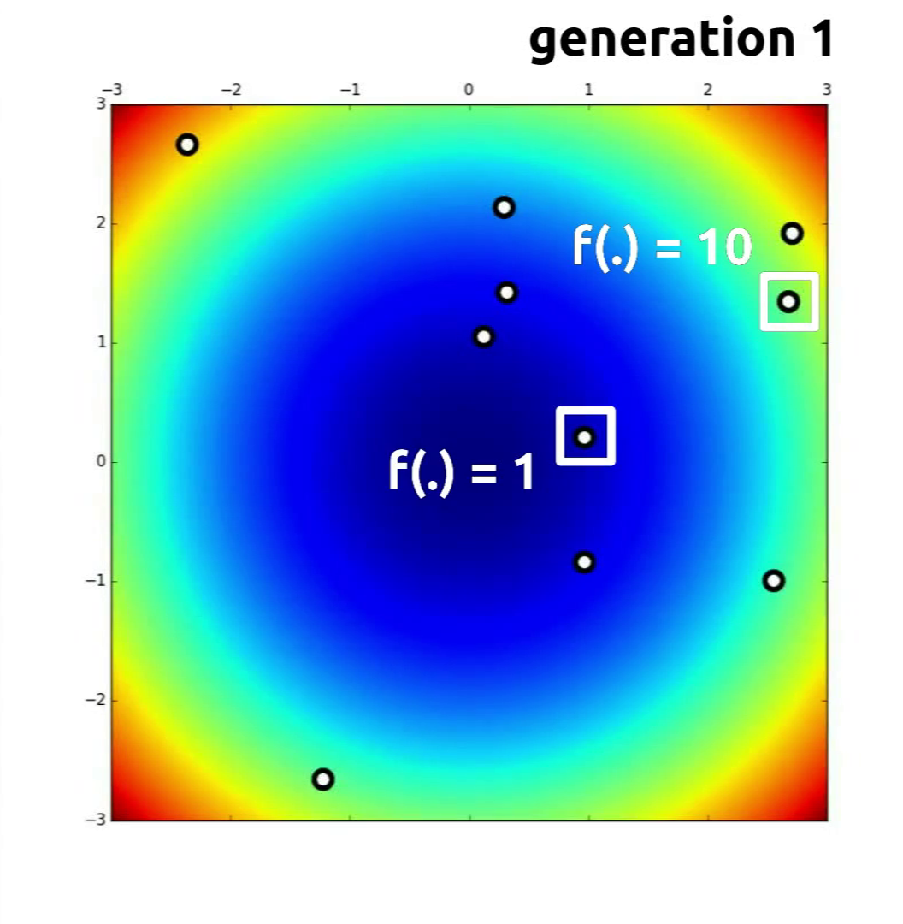
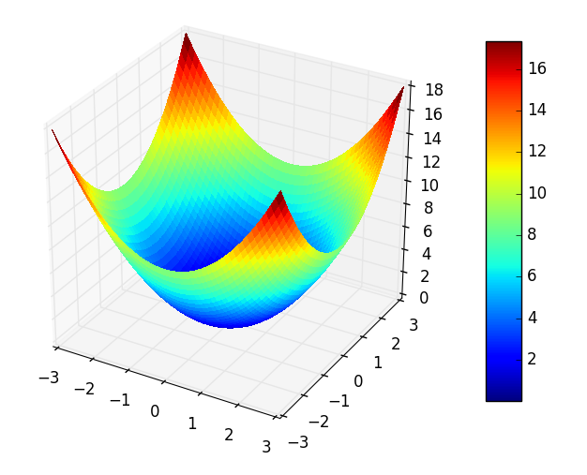
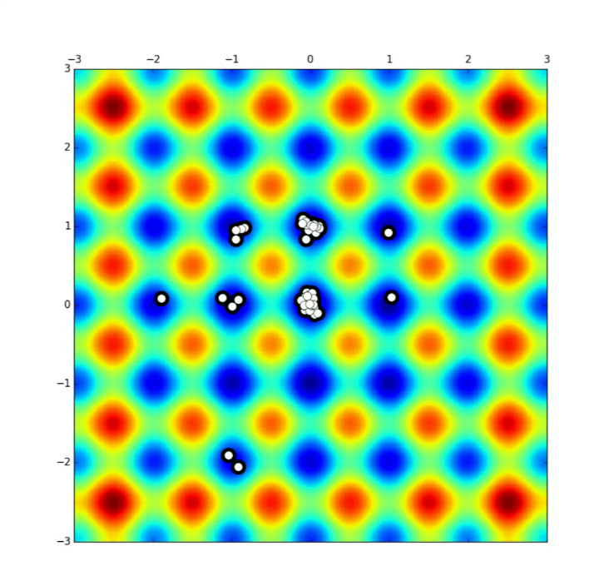
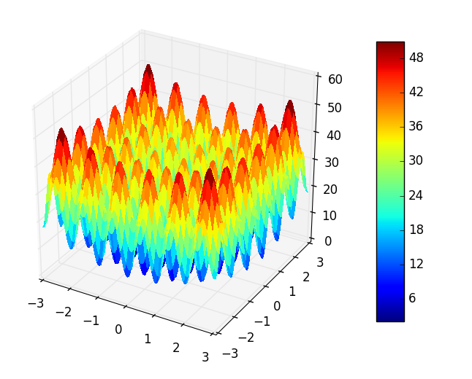
Particle Swarm Optimization (PSO)
$$x_{1}$$
$$f\left(x_{1},x_{2}\right)$$
$$\left[\begin{matrix}x_{1} \\ x_{2}\end{matrix}\right]$$
minimizing
$$f(x_{1},x_{2})$$
$$f\left(2,2\right)=8$$
$$x_{2}$$
$$f\left(x_{1},x_{2}\right)= x_{1}^{2}+ x_{2}^{2}$$
$$f\left(0,0\right)=0$$
(Sphere function)
$$x_{2}$$
$$x_{1}$$
$$x_{1}$$
$$f\left(x_{1},x_{2}\right)$$
$$f\left(x_{1},x_{2}\right)=20+\sum_{i=1}^{2}{[x_{i}^{2} −10 cos⁡(2 π x_{i})]}$$
$$x_{2}$$
(Rastrigin function)
$$x_{2}$$
$$x_{1}$$

Slide 16
Particle Swarm Optimization (PSO)
$$\left[\begin{matrix}x_{1} \\ x_{2}\end{matrix}\right]$$
$$\left[\begin{matrix}x_{1} \\ x_{2}\end{matrix}\right]$$
fitness
$$f(x_{1},x_{2})$$
fitness
$$f(x_{1},x_{2})$$
PSO
simulation
$$\left[\begin{matrix}x_{1} \\ ⋮ \\ x_{n}\end{matrix}\right]=\left[\begin{matrix}θ_{ref} \\ ⋮ \\ G_{SOL}\end{matrix}\right]$$
$$\left(\begin{matrix}robustness \\ speed \\ …\end{matrix}\right)$$
fitness

Slide 17
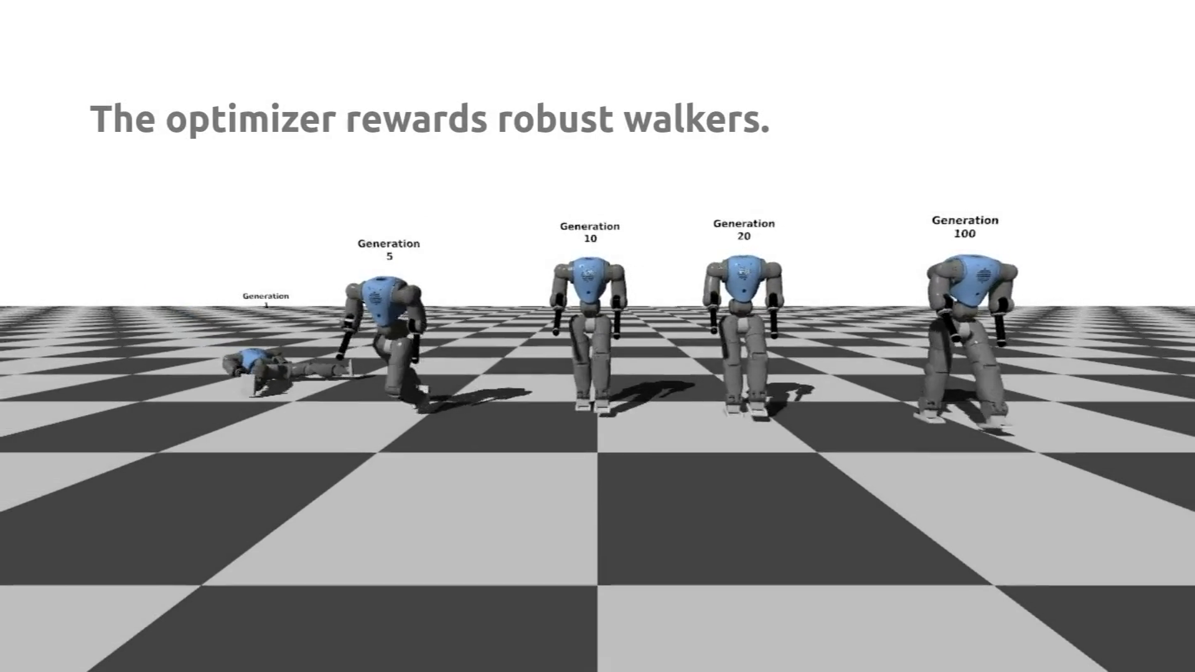
Learning through optimization

Slide 18
Outline
Introduction & Methods
Reflex-based controller
Neuromuscular model
Experimental validation
Adaptation to different robots
Forward gait modulation in 2D scenarios
Steering control in 3D scenarios
Conclusion

Slide 19
Optimized simulation gait for 2D scenarios
The reflex-based controller of [Geyer and Herr, 2010] is optimized in a 2D simulation environment.
The exact same controller is ported to the real robot.

Slide 20
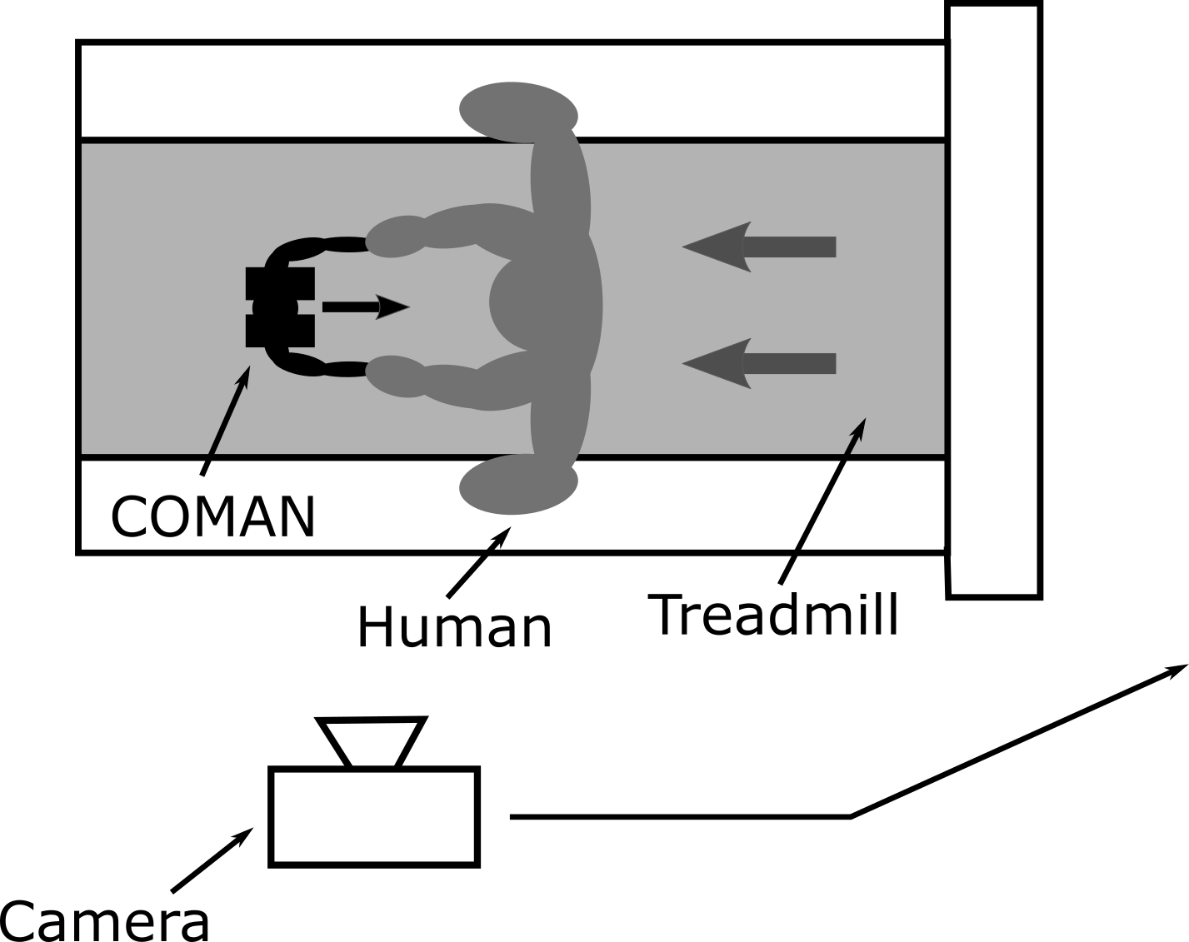
Lateral balance – experimental setup
Lateral balance
constraints in simulation
upper-body control on the real robot
Help from a human operator

Slide 21
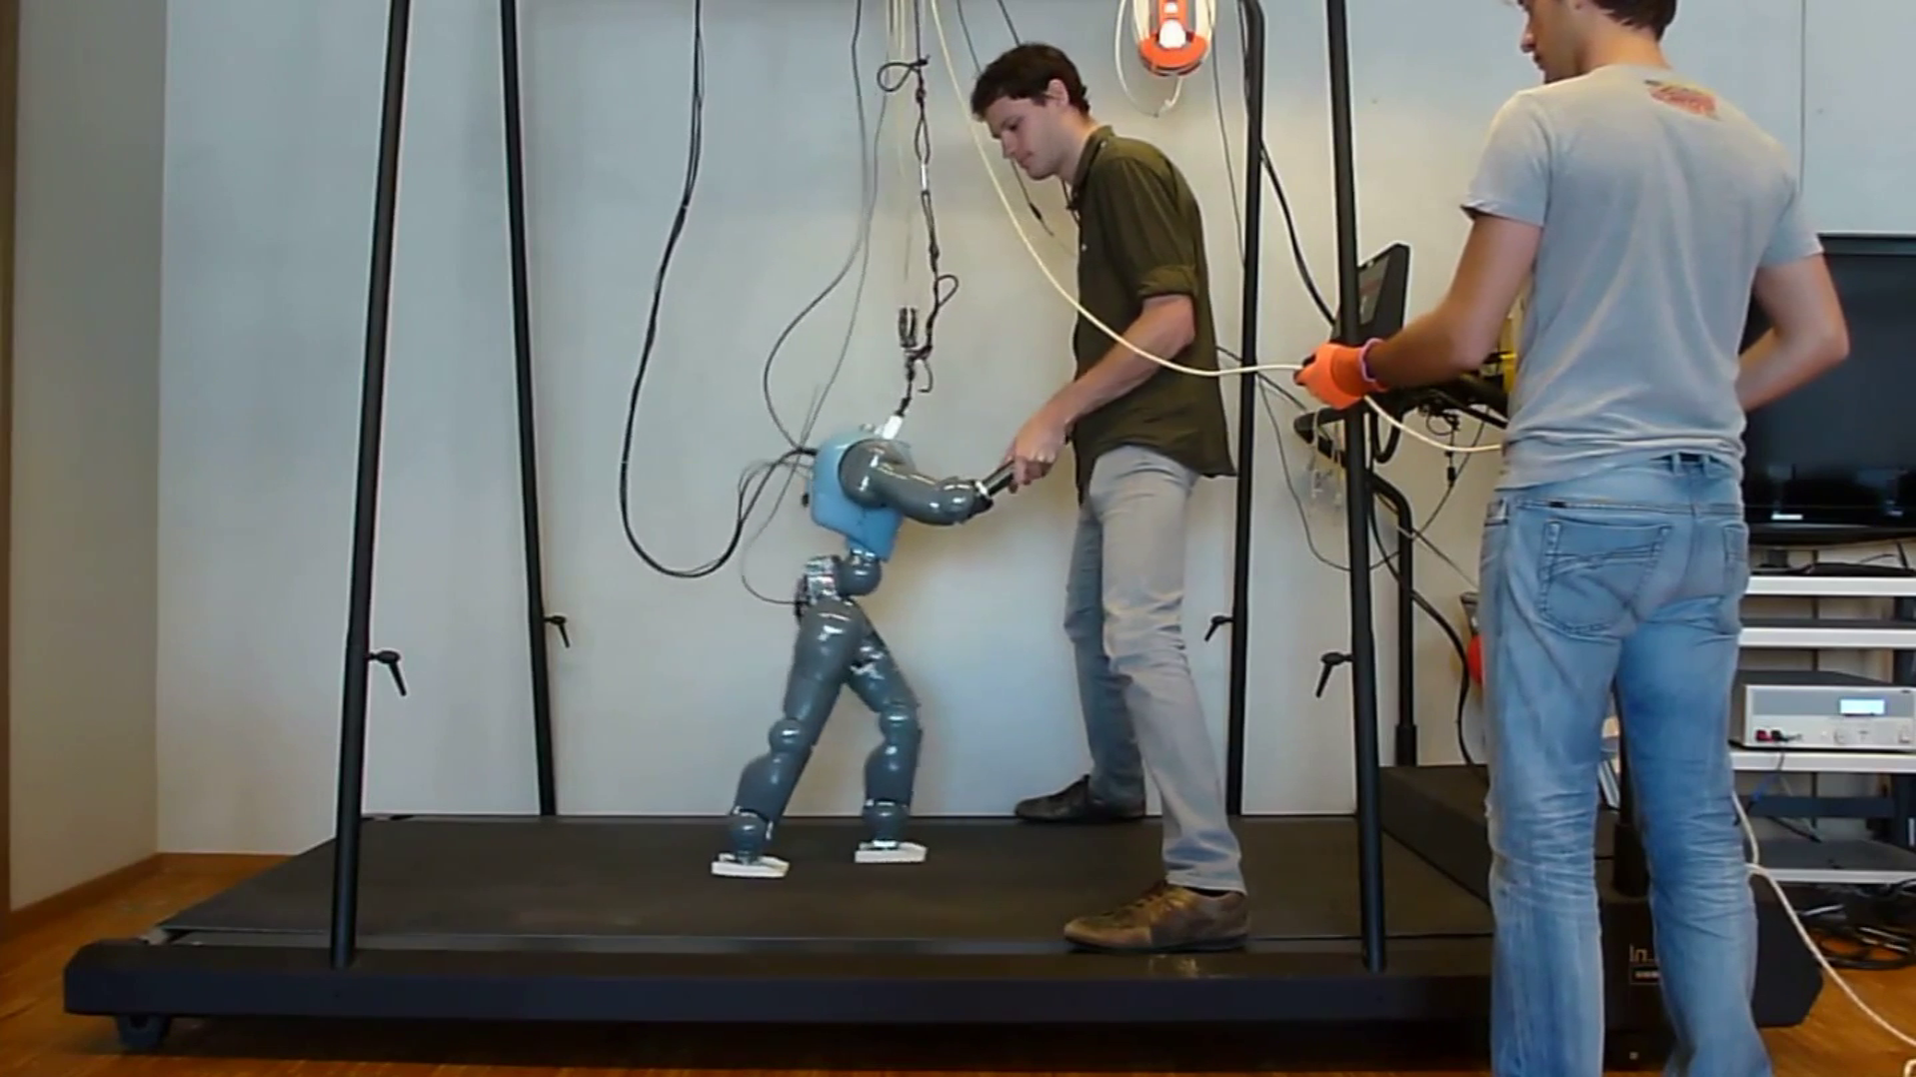
Experimental validation on a treadmill

Slide 22
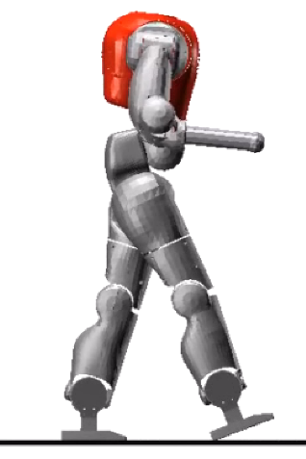
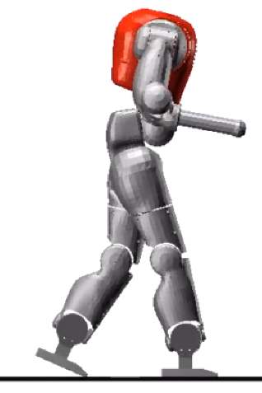
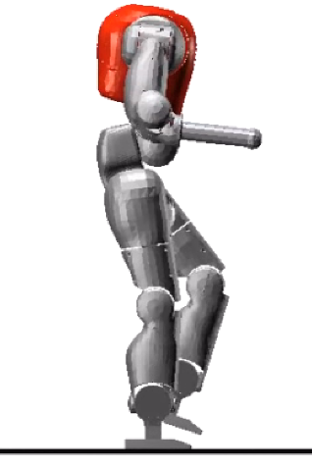
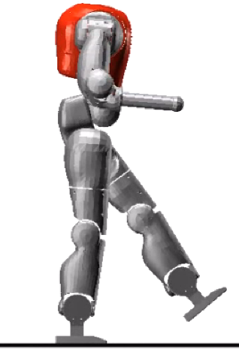
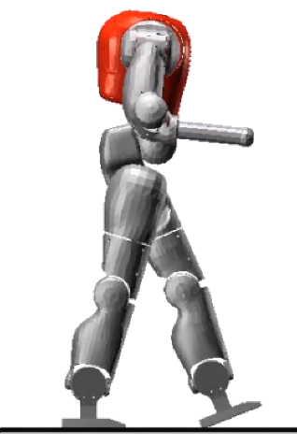
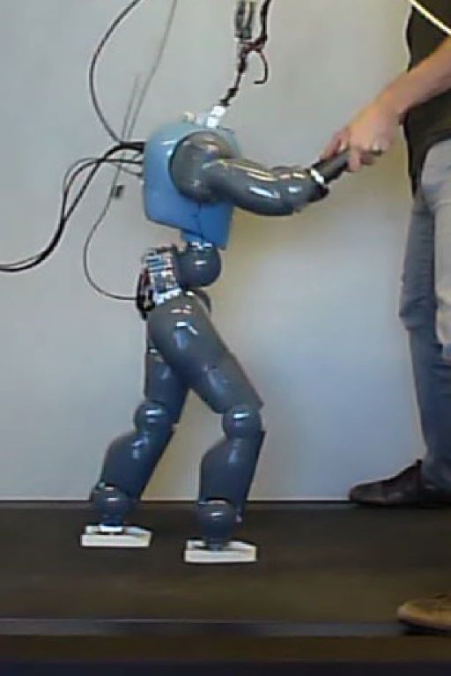
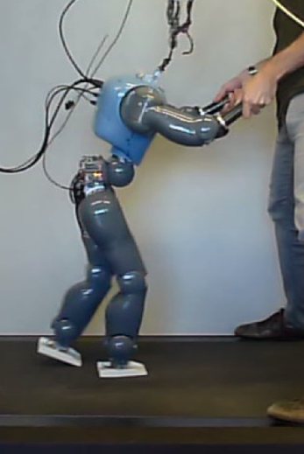
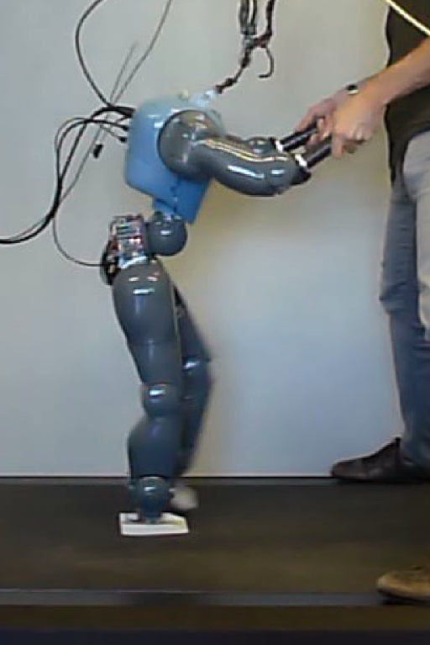
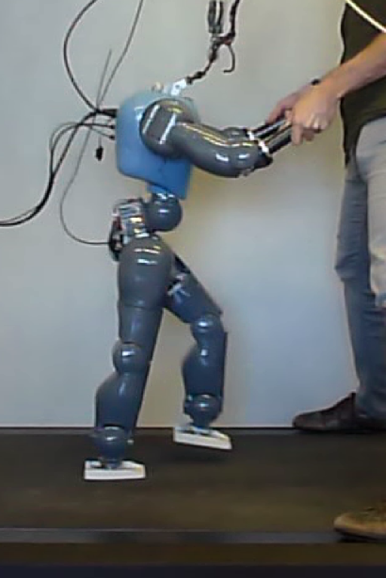
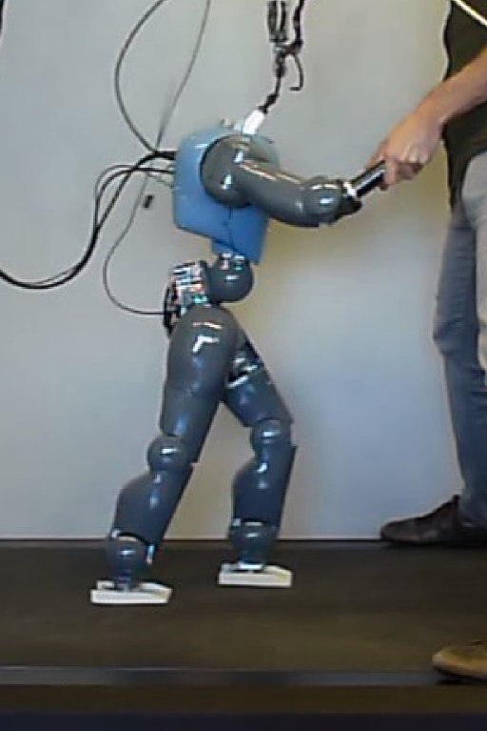
Simulation and experimental gaits

Slide 23
Outline
Introduction & Methods
Reflex-based controller
Neuromuscular model
Experimental validation
Adaptation to different robots
Forward gait modulation in 2D scenarios
Steering control in 3D scenarios
Conclusion

Slide 24
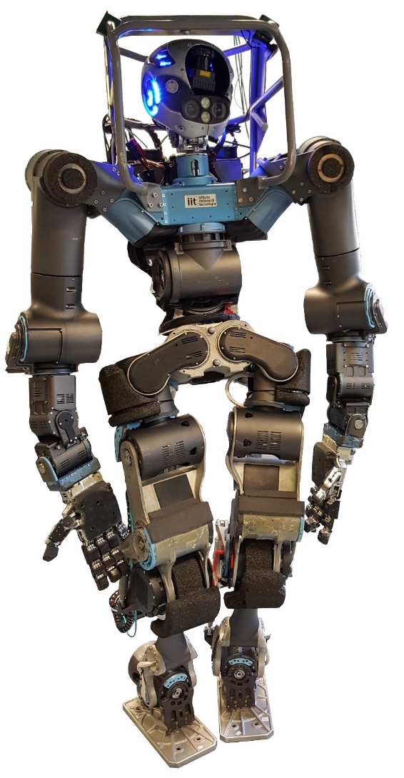
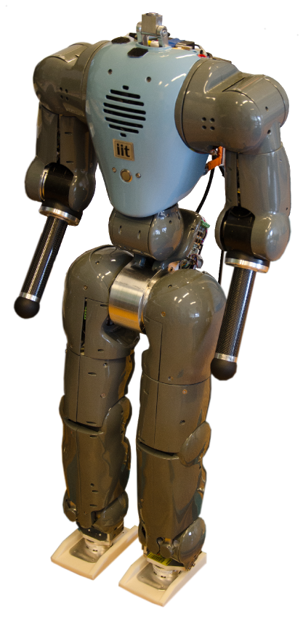
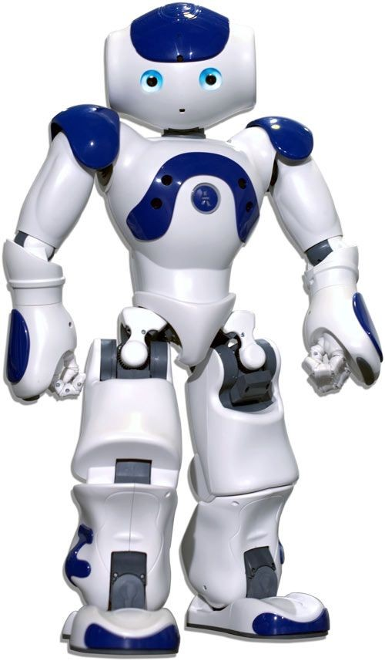
Adaptation to different robots
NAO
COMAN
WALK-MAN
ATLAS
Adrien De Coninck

Slide 25
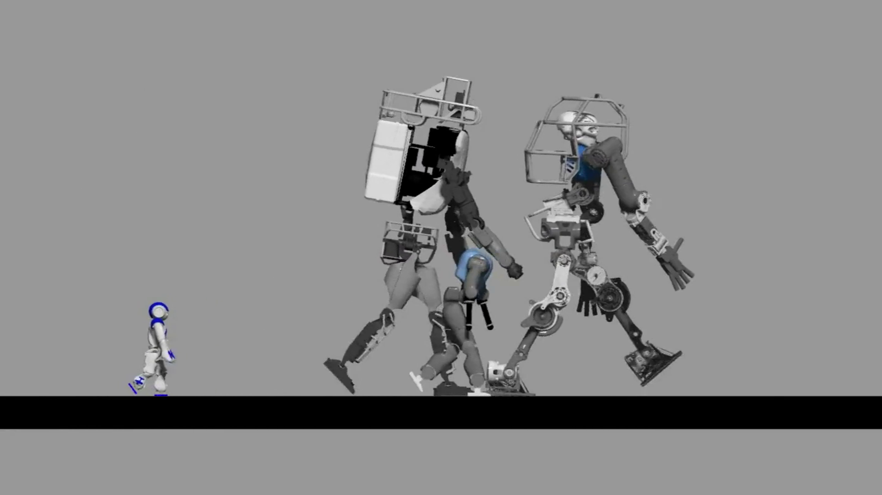
2D walking with different robots

Slide 26
Outline
Introduction & Methods
Reflex-based controller
Forward gait modulation in 2D scenarios
Walking gaits
Running gaits
Steering control in 3D scenarios
Conclusion

Slide 27
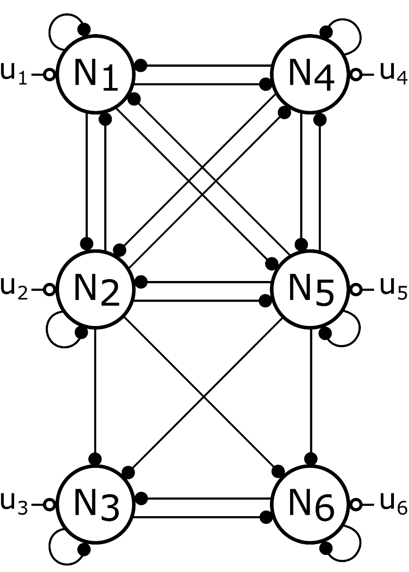
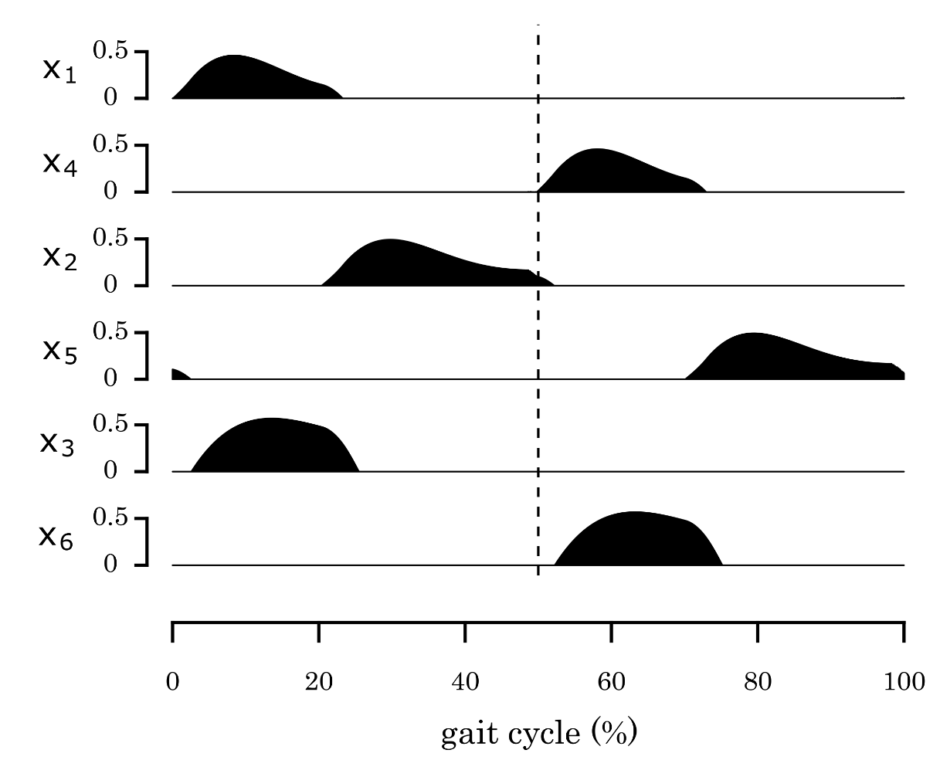
Central pattern generator (CPG)

Slide 28
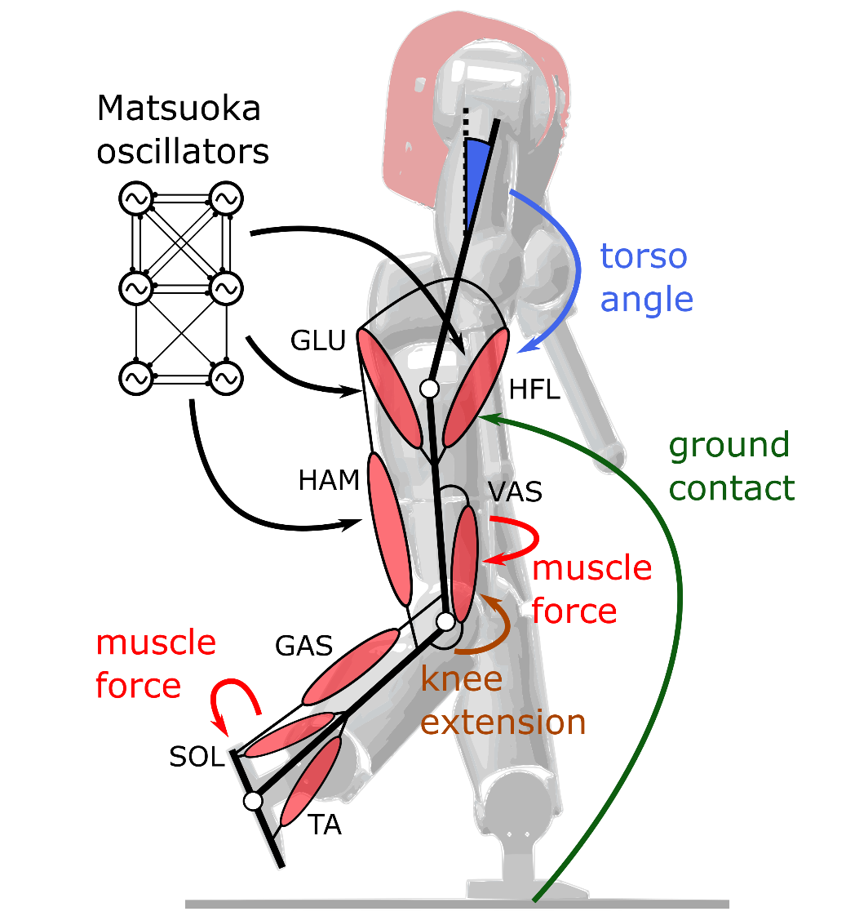
2D walking gaits
Combining reflexes with a CPG
Proximal muscles mainly driven by CPG
Distal muscles mainly driven by reflexes
High-level parameters adapted as linear functions of the target speed
4 CPG parameters
1 reflex parameter
Getting different gaits
Speeds ranging from 0.4 m/s to 0.9 m/s
All parameters co-optimized in one single optimization

Slide 29
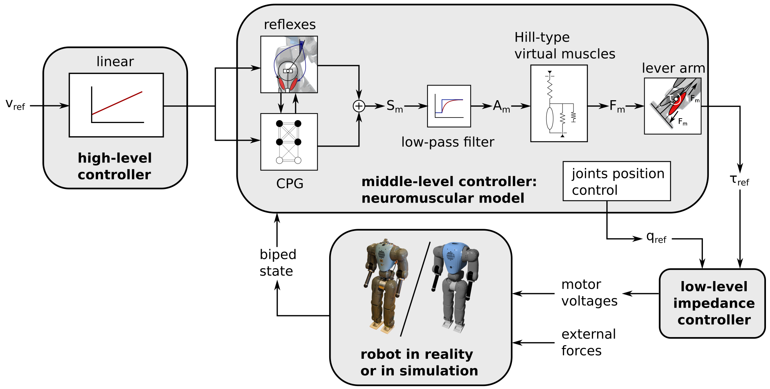
General control framework

Slide 30
Forward speed modulation during 2D walking

Slide 31
Crossing a hole with step length modulation

Slide 32
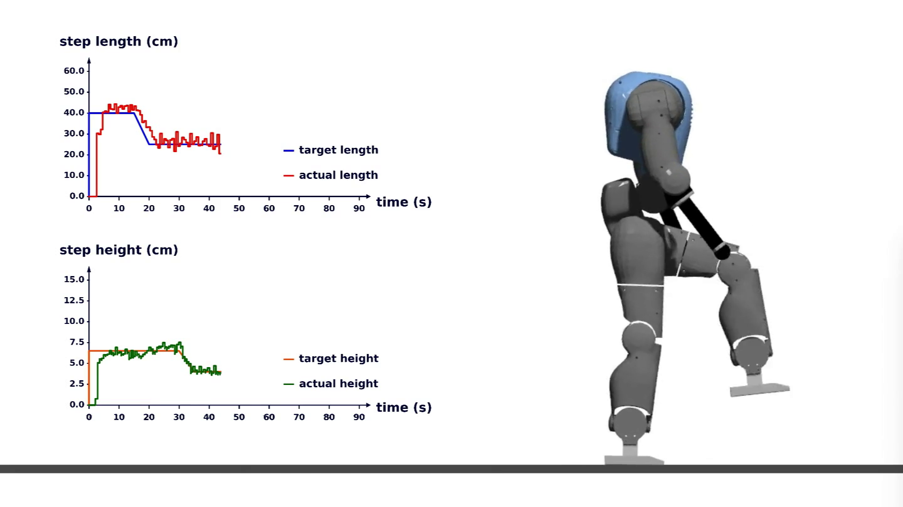
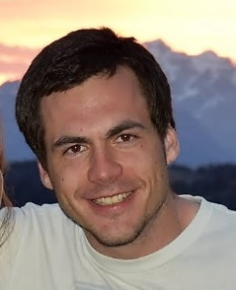
Steph height and length adaptations
Philippe Greiner

Slide 33
Outline
Introduction & Methods
Reflex-based controller
Forward gait modulation in 2D scenarios
Walking gaits
Running gaits
Steering control in 3D scenarios
Conclusion

Slide 34
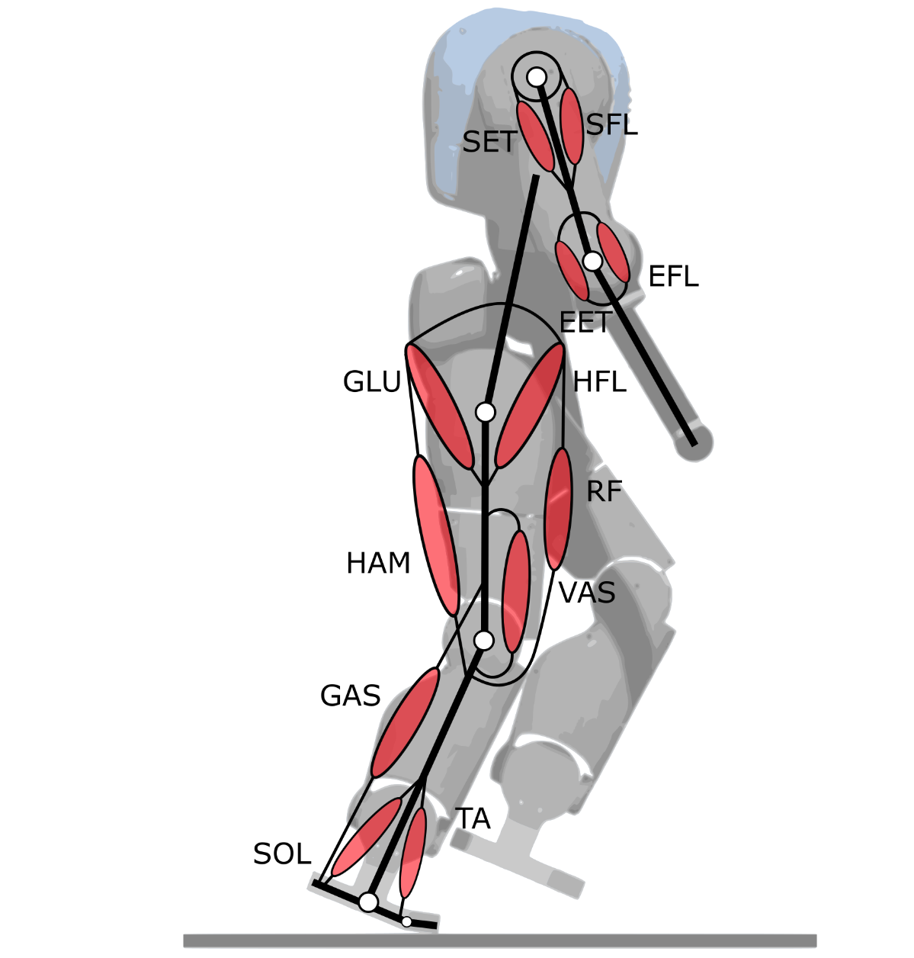
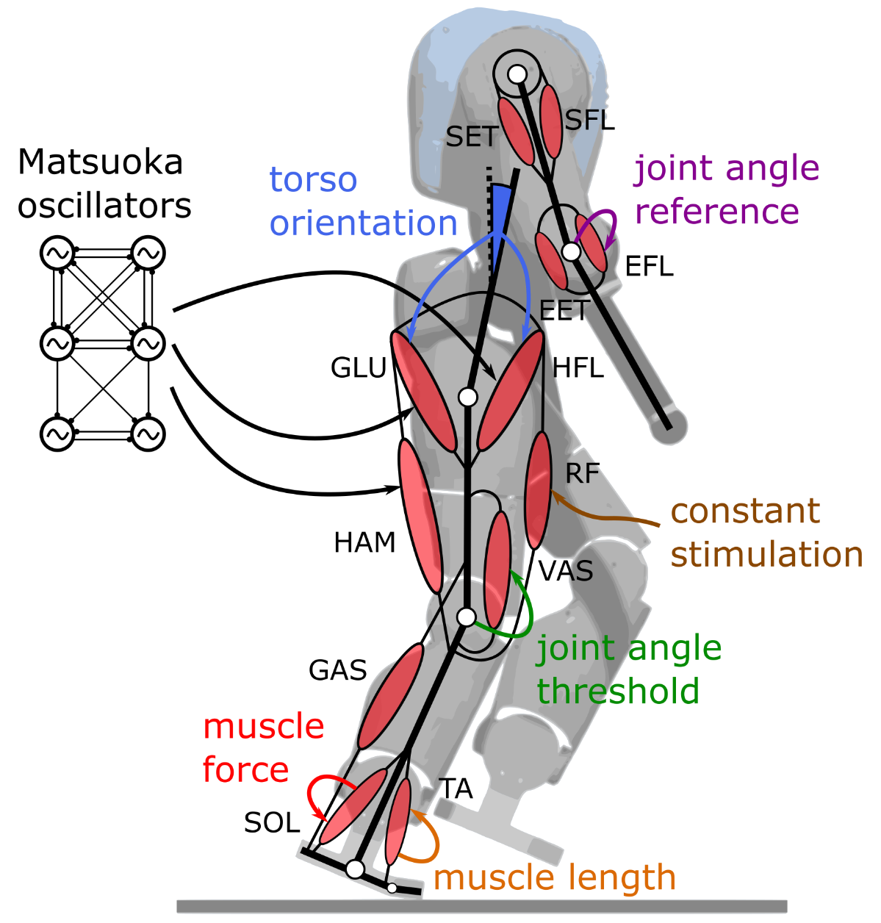
2D running gaits
Extension to running gaits
High-level parameters modulated as functions of the target speed
All parameters co-optimized in one single optimization
Speeds ranging from 1.3 m/s to 1.7 m/s
Bruno Somers
Matthew Harding

Slide 35
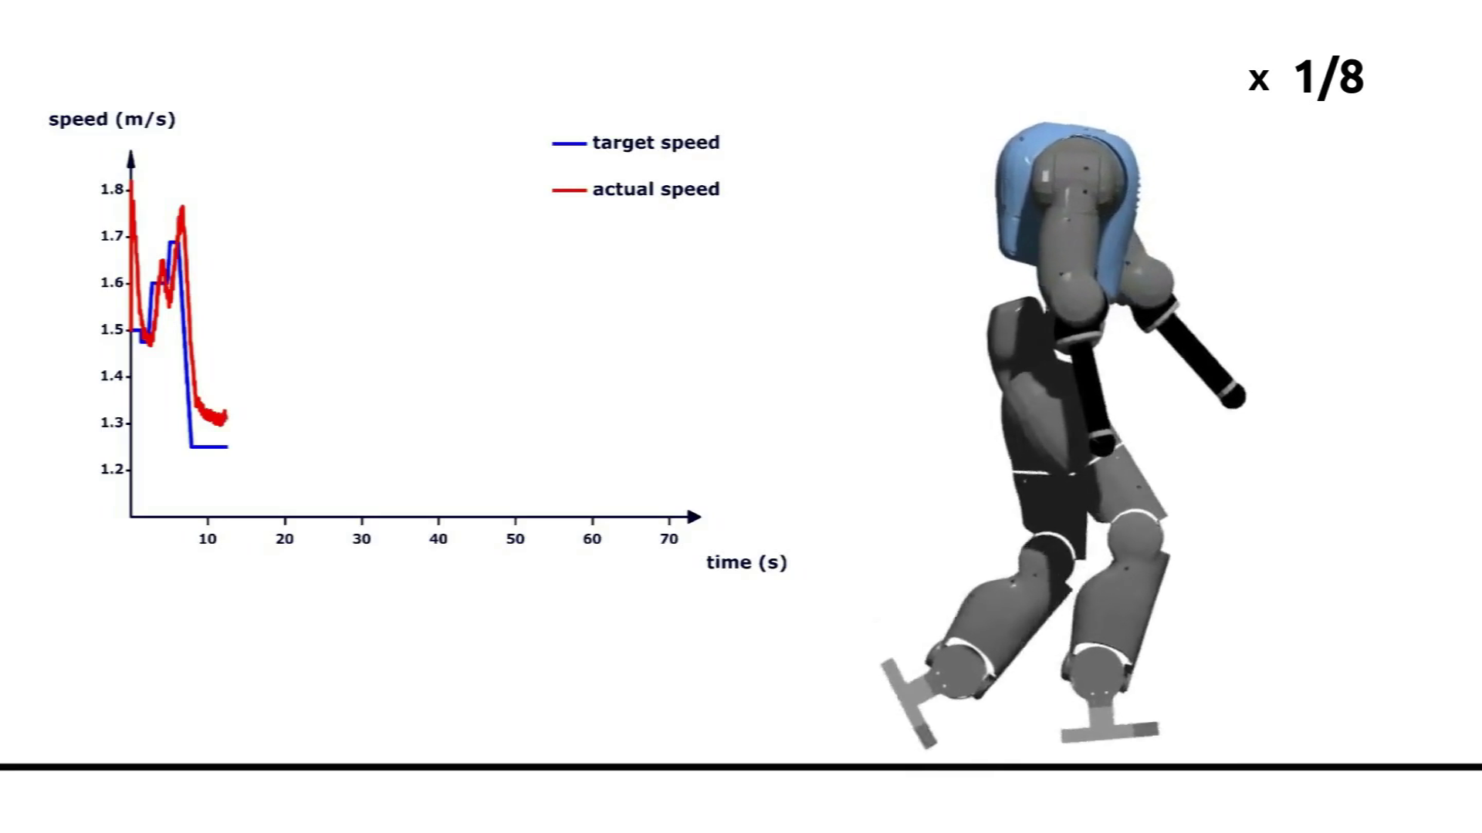
Forward speed modulation during 2D running

Slide 36
Outline
Introduction & Methods
Reflex-based controller
Forward gait modulation in 2D scenarios
Steering control in 3D scenarios
Bio-inspired balance controller
Straight walking
Heading control
Conclusion

Slide 37
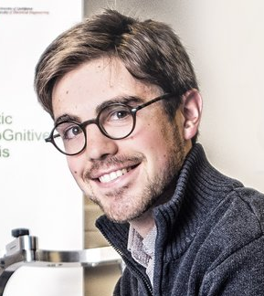
Bio-inspired balance controller
Balance controller
Resist to external perturbations
Automatically learn stimulation patterns
Control the center of mass (COM) position
François Heremans

Slide 38
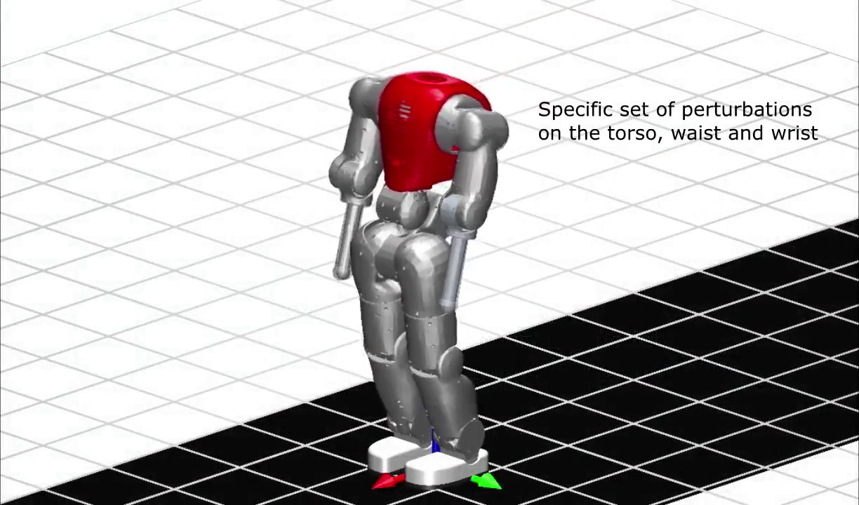
Resisting to external perturbations

Slide 39
Outline
Introduction & Methods
Reflex-based controller
Forward gait modulation in 2D scenarios
Steering control in 3D scenarios
Bio-inspired balance controller
Straight walking
Heading control
Conclusion

Slide 40
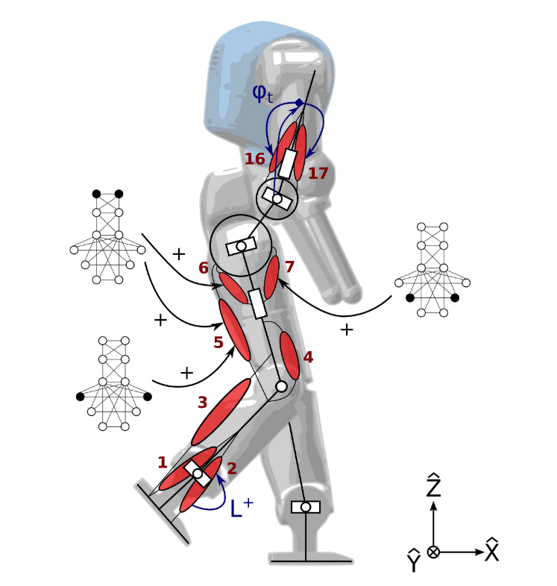
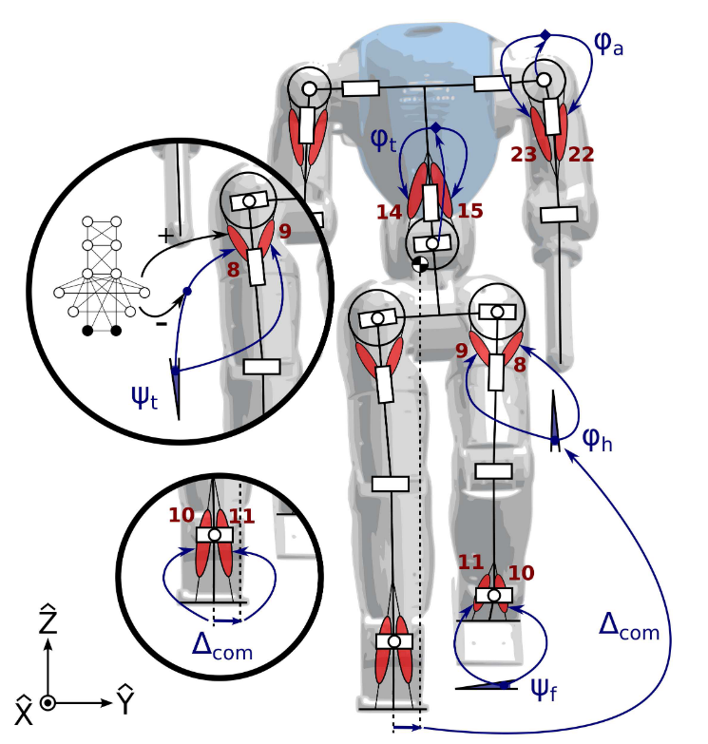
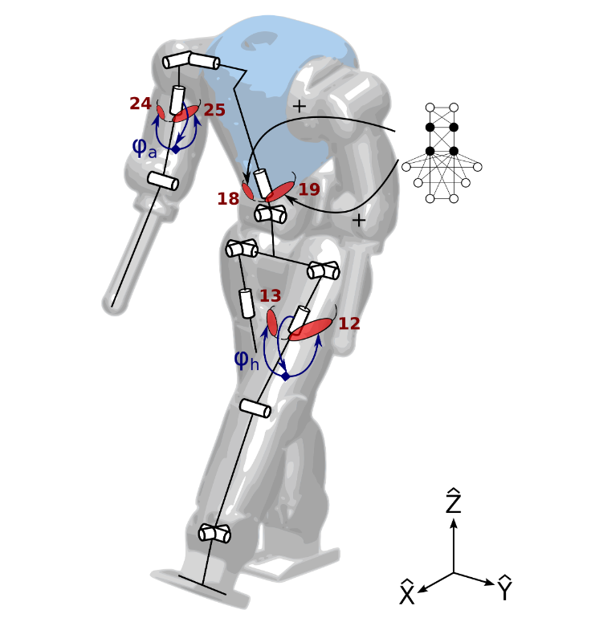
Extension to 3D control
New virtual muscles (in all the planes)
New reflex signals
CPG structure incremented
Sagittal plane
Lateral plane
Transverse plane

Slide 41
CPG structure for straight walking
hip flexion

Slide 42
General control framework

Slide 43
Forward speed tracking

Slide 44
Comparisons to human and tradional data
sagittal ankle angle
sagittal knee angle
sagittal hip angle
neuromuscular
Neuromuscular controller
more human-like
more energetically efficient
faster speeds
human-data
traditional control

Slide 45
Blind walking: stairs

Slide 46
Blind walking: slope

Slide 47
Blind walking impacted by flying balls

Slide 48
Outline
Introduction & Methods
Reflex-based controller
Forward gait modulation in 2D scenarios
Steering control in 3D scenarios
Bio-inspired balance controller
Straight walking
Heading control
Conclusion

Slide 49
CPG structure for heading control

Slide 50
General control framework

Slide 51
Forward speed and steering control

Slide 52
3D walking: avoiding holes

Slide 53
Outline
Introduction & Methods
Reflex-based controller
Forward gait modulation in 2D scenarios
Steering control in 3D scenarios
Conclusion

Slide 54
Original contributions
Reflex-based controller
Experimental validation of a neuromuscular controller
Porting the controllers to different robots
Hill muscle model numerical integration
Feet with human-like compliance
Gait modulation in 2D scenarios
Gait modulation during walking gaits
Speed modulation during running gaits
Steering control in 3D scenarios
Bio-inspired balance controller
Forward speed modulation during straight walking
Heading modulation (steering control)

Slide 55
Future directions
Extend the panel of motions
stairs climbing
side stepping
…
Study gait finalization
Obtain slow walking gaits
speeds below 0.3 m/s
Investigate real human locomotion
Test the 3D walking controller on a real robot
…

Slide 56
Acknowledgements
Advisors
Prof. Renaud Ronsse
Prof. Auke Ijspeert
Master theses & semester project students
François Heremans
Adrien De Coninck
Bruno Somers
Philippe Greiner
Matthew Harding

Slide 57
Acknowledgements
CEREM
BioRob

Slide 58
Acknowledgements

Slide 59
List of publications
Journal papers
Van der Noot N, Ijspeert AJ and Ronsse R (conditionally accepted) Bio-inspired controller achieving forward speed modulation with a 3D bipedal walker. International Journal of Robotics Research.
Zobova AA, Habra T, Van der Noot N, Dallali H, Tsagarakis NG, Fisette P and Ronsse R (2017) Multi-physics modelling of a compliant humanoid robot. Multibody System Dynamics 39 (1-2), pp. 95-114.
Conference papers
Heremans F, Van der Noot N, Ijspeert AJ and Ronsse R (2016) Bio-inspired balance controller for a humanoid robot. In: 2016 6th IEEE International Conference on Biomedical Robotics and Biomechatronics (BioRob), Singapore, 26-29 June 2016, pp. 441-448.
Colasanto L, Van der Noot N and Ijspeert AJ (2015) Bio-inspired walking for humanoid robots using feet with human-like compliance and neuromuscular control. In: 2015 IEEE-RAS 15th International Conference on Humanoid Robots (Humanoids), Seoul, 3-5 Nov. 2015, pp. 26-32.

Slide 60
List of publications
Van der Noot N, Colasanto L, Barrea A, van den Kieboom J, Ronsse R and Ijspeert AJ (2015) Experimental validation of a bio-inspired controller for dynamic walking with a humanoid robot. In: 2015 IEEE/RSJ International Conference on Intelligent Robots and Systems (IROS), Hamburg, Sept. 28 2015-Oct. 2 2015, pp. 393-400.
Zobova AA, Habra T, Van der Noot N, Dallali H, Tsagarakis NG, Fisette P and Ronsse R (2015) Multi-physics modelling of a compliant humanoid robot. In: ECCOMAS Thematic Conference Multibody Dynamics 2015, Barcelona, 29 June-02 July 2015.
Van der Noot N, Ijspeert AJ and Ronsse R (2015) Biped gait controller for large speed variations, combining reflexes and a central pattern generator in a neuromuscular model. In: 2015 IEEE International Conference on Robotics and Automation (ICRA), Seattle, WA, 26-30 May 2015, pp. 6267-6274.
Van der Noot N and Barrea A (2014) Zero-Moment Point on a bipedal robot under bio-inspired walking control. In: MELECON 2014 - 17th IEEE Mediterranean Electrotechnical Conference, Beirut, 13-16 April 2014, pp. 85-90. DOI: 10.1109/MELCON.2014.6820512.

Slide 61
List of publications
Poster presentations
Van der Noot N, Ijspeert AJ and Ronsse R (2016) Neuro-Muscular Controller Based on Reflexes and a Central Pattern Generator to Achieve Gait Modulation. In: KoroiBot Final Workshop, Heidelberg, 13-14 September 2016.
Van der Noot N, Ijspeert AJ and Ronsse R (2016) Humanoid Robot Control Recruiting Muscles, Reflexes and a Central Pattern Generator. In: IEEE-EMB Benelux Chapter and the 14th National Day on Biomedical Engineering, Brussels, 4 March 2016.
Van der Noot N, Colasanto L, Ronsse R and Ijspeert AJ (2015) Porting Reflex-Based Muscles Control to Real Humanoid Robots. In: 2015 IEEE International Conference on Robotics and Automation (ICRA) - Workshop on Dynamic Locomotion and Balancing, Seattle, WA, 26 May 2015.
Van der Noot N, Dzeladini F, Ijspeert AJ and Ronsse R (2014) Simplification of the Hill Muscle Model Computation for Real-Time Walking Controllers with Large Time Steps. In: Dynamic Walking, Zurich, 10-13 June 2014.

Slide 62
Respice finem

Slide 63
Outline
Introduction & Methods
Reflex-based controller
Forward speed modulation in 2D scenarios
Steering control in 3D scenarios
Conclusion
Supplementary material

Slide 64
Hill muscle model integration problem

Slide 65
Hill muscles: computing the steady-state values
Look Up Table (LUT)
Third-order polynomial (TOP)
Newton-Raphson scheme (NRS)

Slide 66
Hill muscles: steady-state approximation results

Slide 67
Combining approximations and full dynamics

Slide 68
Real experiment: simulation and experimental gaits
Simulation
Real robot
non-stretched
leg
knee flexion
knee flexion
stretched leg
stretched leg
knee
knee
Position (rad)
ankle
ankle
hip
hip
ankle
ankle
Torque (Nm)
knee
knee
hip
hip

Slide 69
Real experiment: vertical feet forces
Simulation forces
Real experiment
forces

Slide 70
Real experiment: long walk

Slide 71
Feet with human-like compliance
force (N)
real
approximation
Flex-Foot Junior prosthesis
deflexion (mm)
Force-displacement characteristic
Compliant foot design
Luca Colasanto

Slide 72
Feet comparisons: ground bumps description

Slide 73
Compliant feet on uneven terrains

Slide 74
Feet comparisons on uneven terrains

Slide 75
Feet comparisons: energy and robustness
Human-like foot
Rigid shaped foot
Rigid flat foot
Energy efficiency
Robustness
energy (J $m^{−1}$ ${kg}^{−1}$)
steps (-)
speed (m/s)
obstacles height (mm)

Slide 76
Feet comparisons: stride length and period
Stride length
Stride period

Slide 77
Real experiment: flexible feet

Slide 78
2D walking: speed parameters

Slide 79
2D walking: metabolic energy consumption
Small increase in energy consumption for the adaptive-CPG controller.
Reasonable price to pay for the resulting versatility.
pure-reflex
fixed-CPG
adaptive-CPG
energy (J $m^{−1}$ ${kg}^{−1}$)
speed (m/s)

Slide 80
2D walking: characteristics

Slide 81
2D running: speed parameters (I)

Slide 82
2D running: speed parameters (II)

Slide 83
2D running: characteristics

Slide 84
Pushes: feet contact forces

Slide 85
Learning process

Slide 86
Neural controller: a regression engine
Learning
Sensors
Regression
-
Prediction
Training reference
CMAC
Cerebellum Model for Articulation Control (CMAC)
Based on the cerebellum organization
Neural network
[Smith 1998]
Support Vector Regression (SVR)
Mathematical model
Data points selected as support vectors
SVR

Slide 87
Torques reconstruction
reconstruction
reference

Slide 88
Stimulations reconstruction

Slide 89
COG ration: sagittal plane

Slide 90
COG ration: transverse plane

Slide 91
Learning performances
Cognitive control ratio
$$\frac{training time}{elapsed simulation time}$$

Slide 92
CPG structure for straight walking
PF
RG
Rhythm generator (RG)
Pattern formation (PF)
RG
PF
PF

Slide 93
3D straight walking: characteristics

Slide 94
3D walking: speed parameters (I)

Slide 95
3D walking: speed parameters (II)

Slide 96
Comparisons to human and LIP-based data
Rneur = 0.8
Δneur = -9 %
RLIP = 0.32
ΔLIP = -40 %
Rneur = 0.95
Δneur = 0 %
RLIP = 0.87
ΔLIP = -6 %
Rneur = 0.97
Δneur = 0 %
RLIP = 0.93
ΔLIP = 0 %
sagittal ankle angle
sagittal knee angle
sagittal hip angle
Rneur = 0.92
Δneur = -5 %
RLIP = 0.89
ΔLIP = 29 %
Rneur = 0.24
Δneur = 82 %
RLIP = 0.71
ΔLIP = -19 %
human-data
LIP-based
neuromuscular
Rneur = 0.53
Δneur = -3 %
RLIP = 0.66
ΔLIP = -1 %
sagittal ankle torque
sagittal knee torque
sagittal hip torque

Slide 97
Comparisons to human and LIP-based data
Rneur = 0.96
Δneur = 1 %
RLIP = 0.98
ΔLIP = 3 %
human-data
LIP-based
neuromuscular
vertical ground reaction forces
Rneur = 0.96
Δneur = -14 %
human soleus EMG
COMAN soleus activation

Slide 98
Energetic consumption: square torques integration
square torques per gait cycle,
divided by traveled distance
square torques per gait cycle

Slide 99
Robustness: facing unknown slopes
negative slopes
positive slopes
traveled distance (m)
traveled distance (m)

Slide 100
Robustness: blind walking on irregular ground
traveled distance (m)
ground description

Slide 101
Blind walking on irregular ground

Slide 102
Full 3D control
New virtual muscles (in all the planes)
New reflex signals
CPG structure incremented
Sagittal plane
Lateral plane
Transverse plane

Slide 103
Heading control: speed parameters

Slide 104
Walking curvature

Slide 105
Steering characteristics

Slide 106
Steering robustness

Slide 107
Footprints during steering

Slide 108
Robotran: real-time features

Slide 109
OpenGL features

Slide 110
Primitive shapes contact model

Slide 111
LMECA 2732 (UCL) & MICRO-452 (EPFL) courses

Slide 112
Zero-moment point

Slide 113
Zero-moment point computation

Slide 114
Zero-moment point: recursion

Slide 115
Zero-moment point results: 2D walking
No foot information,
no post-process filtering
Foot orientation provided,
no post-process filtering

Slide 116
Zero-moment point results: 3D walking
Foot orientation provided,
no post-process filtering
Foot orientation provided,
100 ms running-average

